Slide 1
NFL Passing Offense Performance Study
By Pradhan Kolli

Slide 2
Key Question
Purpose
Who Benefits?
How do passing-related statistics influence team success in the NFL?
Do common passing metrics such as yards, touchdowns, interceptions, and sacks meaningfully predict offensive effectiveness and wins?
NFL teams and front offices
Coaches and offensive coordinators
Analysts and sports data scientists
Fans interested in advanced football analytics

Slide 3
Methodology
Data Preparation
Feature Selection
Analysis Approach
Found a CSV from Pro Football Reference:
Passing 2023
Cleaned Data and saved it to a CSV
Selected key passing metrics:
passing yards, passing touchdowns, interception percentage, sack percentage, Total QBR, and team wins
Ranked teams to identify top performers in passing production
Used correlation analysis to measure relationships between passing metrics and team success

Slide 4
Implementation

Slide 5


Tools

Slide 6
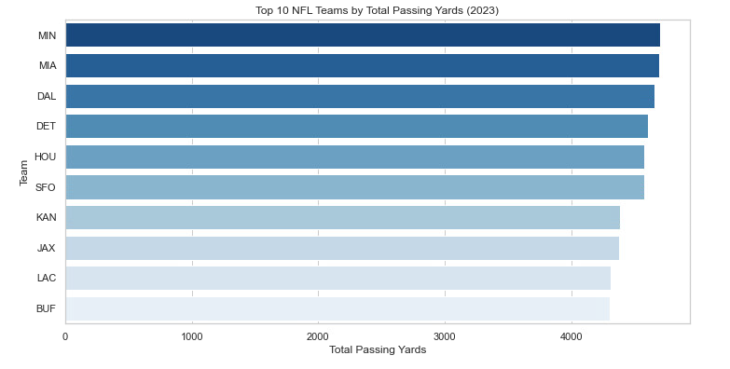

Slide 7
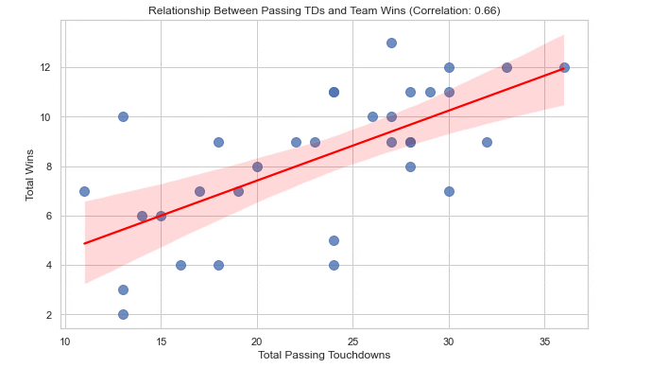

Slide 8
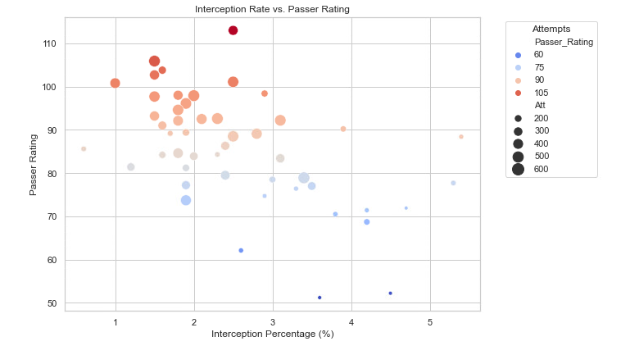

Slide 9
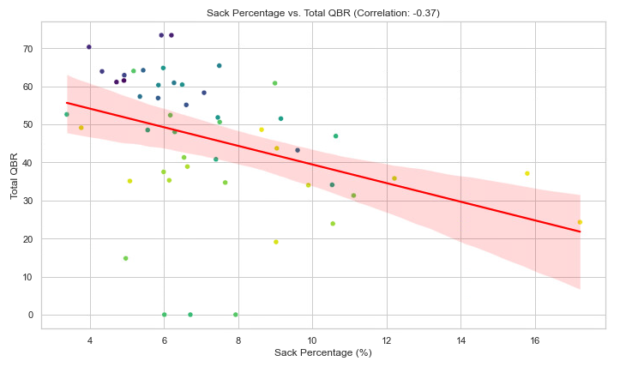

Slide 10
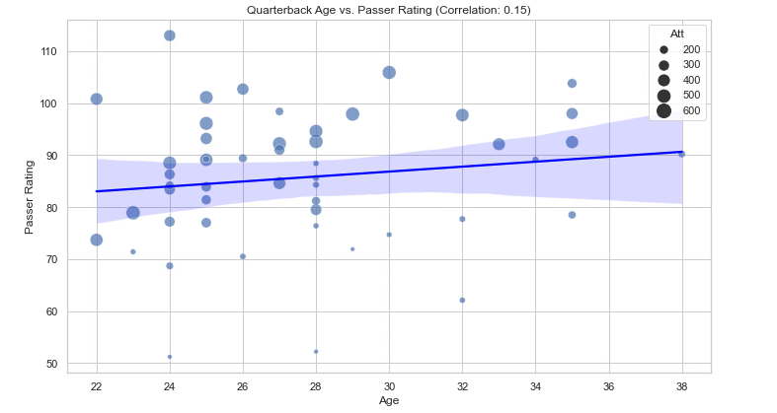

Slide 11
Results
Passing Volume vs. Success
Teams with high passing yardage establish a strong offensive baseline
Yardage alone does not guarantee winning
Touchdowns and Wins
Clear positive correlation between passing touchdowns and team wins
Scoring efficiency matters more than raw production

Slide 12
Results (cont.)
Interceptions
Strong negative correlation between interception percentage and passer rating
Turnovers significantly reduce offensive efficiency
Sacks and QBR
Higher sack percentages correlate with lower Total QBR
Protection and pocket awareness are critical

Slide 13
Conclusions
Passing efficiency outweighs passing volume
Touchdowns are more predictive of wins than yards
Interceptions and sacks significantly harm quarterback performance

Slide 14
Future Work
Incorporate defensive metrics to control for opponent strength
Expand analysis across multiple seasons to identify long-term trends
Analyze situational performance by down, distance, and red-zone efficiency

Slide 15
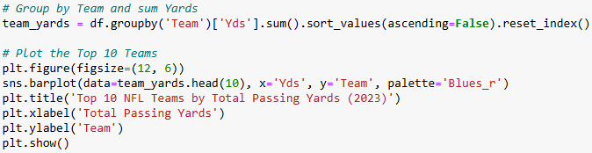
Appendices
Graph 1:

Slide 16
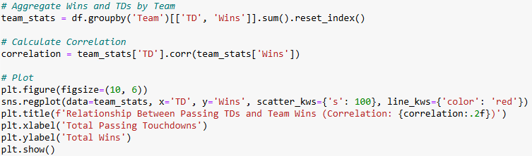
Appendices
Graph 2:

Slide 17
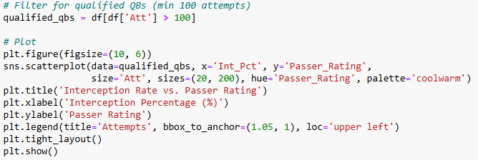
Appendices
Graph 3:

Slide 18
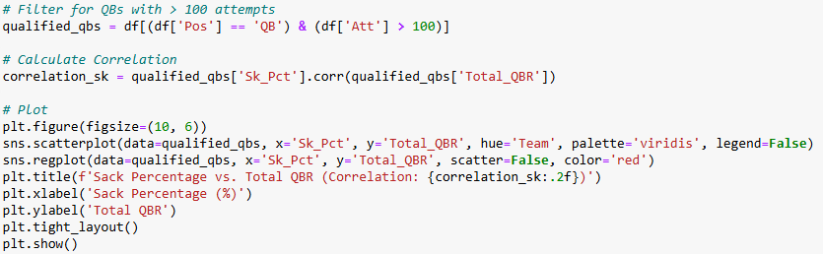
Appendices
Graph 4:

Slide 19
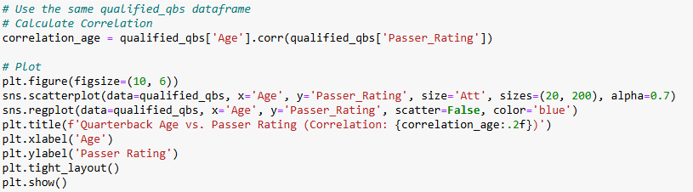
Appendices
Graph 5:

